Slide 1

NIM BOT
Chinmay Naik 112003093
Kishor Murade 112003091

Slide 2

Introduction to Project
NIM GAME - Given a number of piles in which each pile contains some number of objects. In each turn, a player can choose only one pile and remove any number of objects (atleast one) from that pile. The player who takes the last stone is the winner.
Here we use the concept of NIM SUM - The cumulative XOR value of the number of objects in each pile at any point of the game is called Nim-Sum at that point. The optimal strategy for each player is to make the Nim-Sum zero for his opponent in each of their turn.

Slide 3
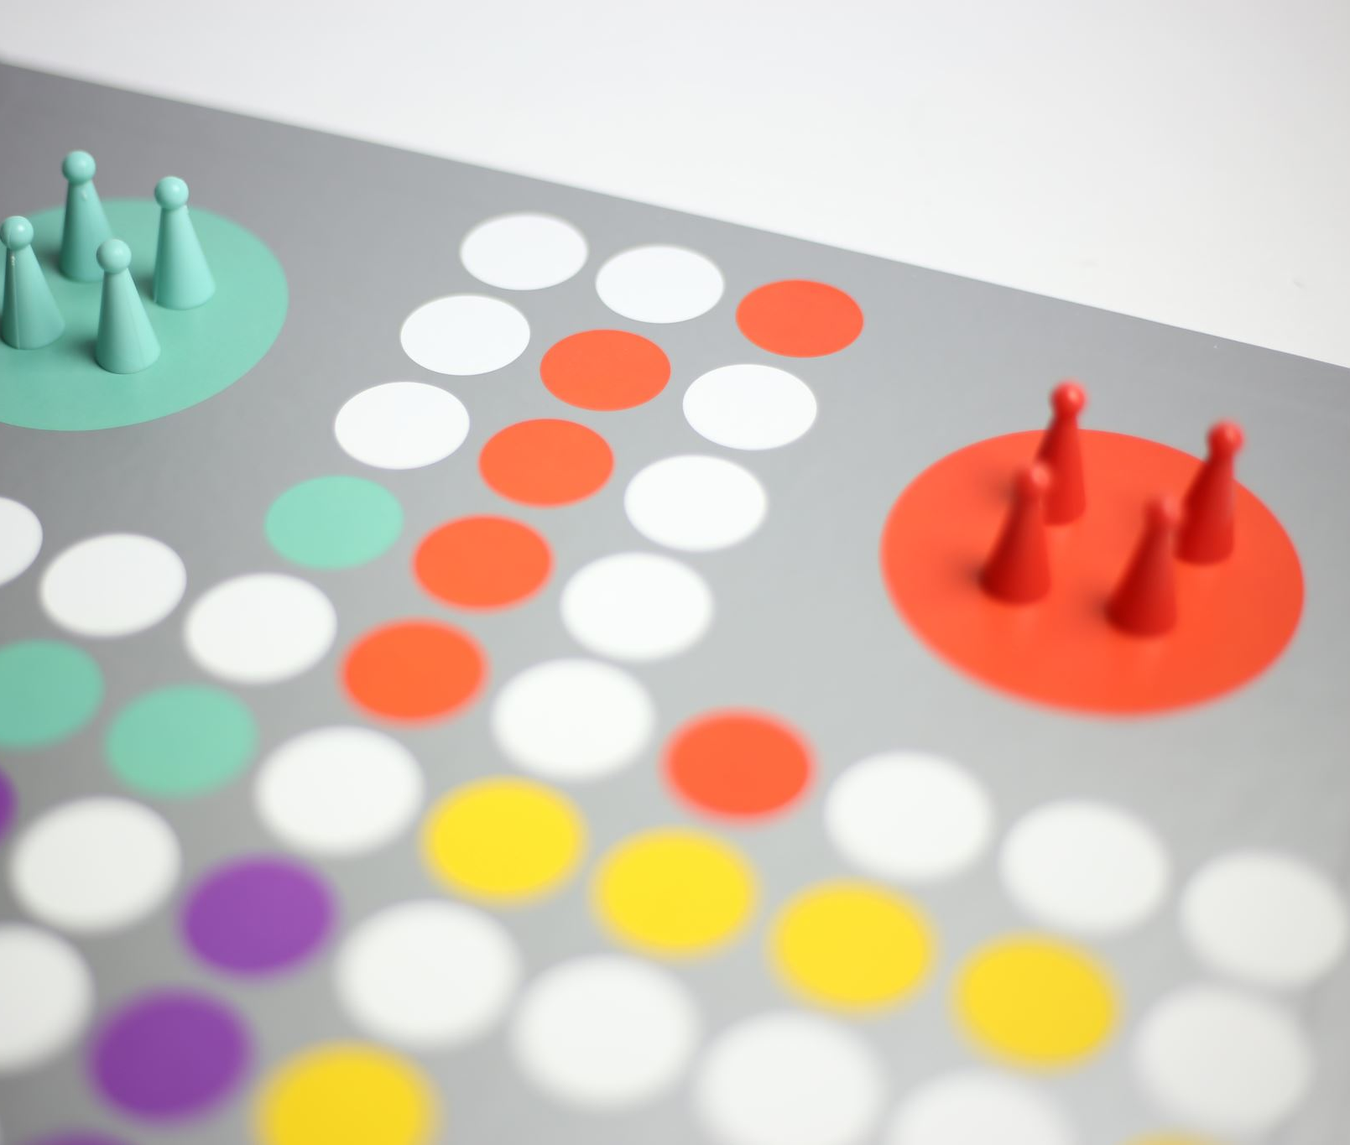
Problem Statement
Design an AI program for the game of nim based on varying difficulty levels(which depends on whether the board at a particular instance is balanced or not). The project is based on adversarial game technique.
The user will get every alternate chance to maximize his/her score
The goal of the bot is to maximize the chances of winning based on the difficulty level chosen

Slide 4

Project description
1. Performance Measure: Win or Lose
2.Environment Type: Fully Observable, multi-agent, deterministic, sequential, static, discrete environment consisting of n number of piles of coins each having a variable number of coins individually
3. Actuators: Remove any number of coins from any piles of coins
4.Sensors: Program

Slide 5
Methodology and Proposed Solution
1. Initialise the game with default:
mode = player vs player
player 1 = 1, player 2 = 2
winner = none
GUI for the game
2. Load menu for selecting mode
3. Select mode to load another menu accordingly
4. For player vs AI mode
while winner not declared
a. if current player is player 1
remove valid amount of an object from a valid row
print move
b. else
initialize board balanced to False
copy game board
check if the copied game board is balanced
if already balanced, remove 1 object from the first non-empty pile
else
for row in rows
remove objects one by one from that row
if board is balanced, change board balanced to True and break
if row becomes 0, recopy the original board
print move
c. if winner declared, end game
d. else change player and continue
5. For player vs player mode
while winner not declared
a. if current player is player 1
remove valid amount of an object from a valid row
print move
b. else
remove valid amount of an object from a valid row
print move
c. if winner declared, end game
d. else change player and continue

Slide 6
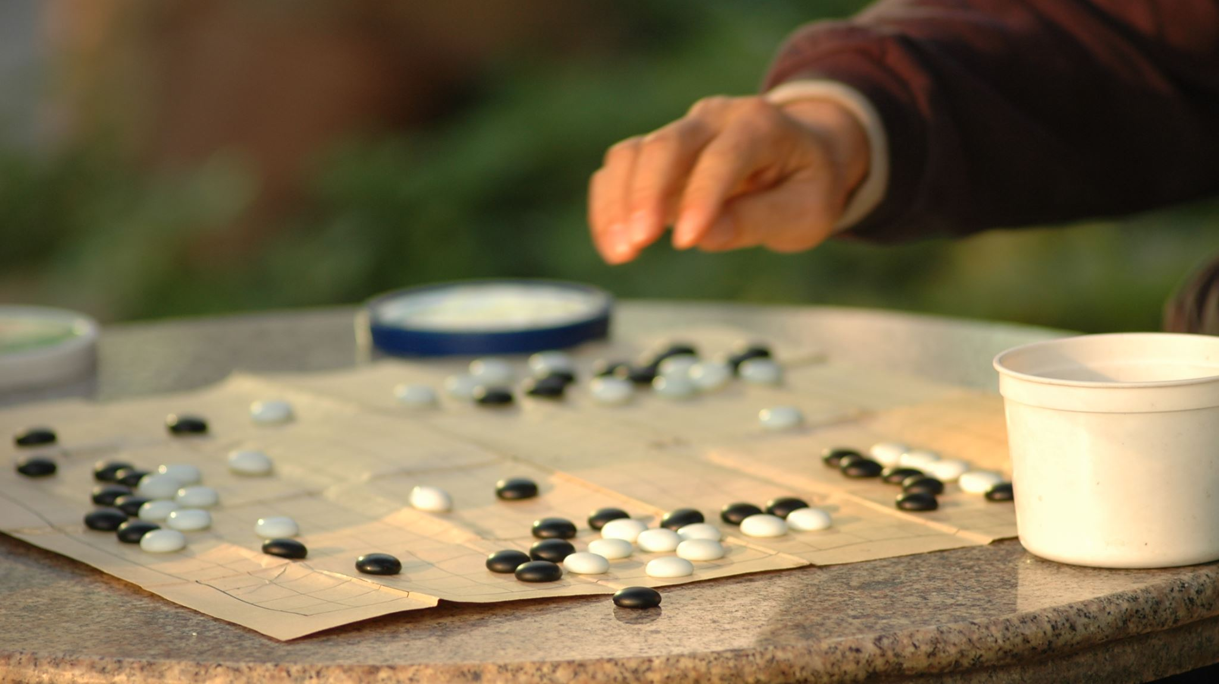
Conclusion
We learnt about Combinatorial Game Theory and how to implement Nim Game in which both the players try to make the Nim-Sum zero in order to win the game.
We also learnt a lot about the pygame library, which we have used to make the GUI of the game.

Slide 7

Thank You

